Slide 1
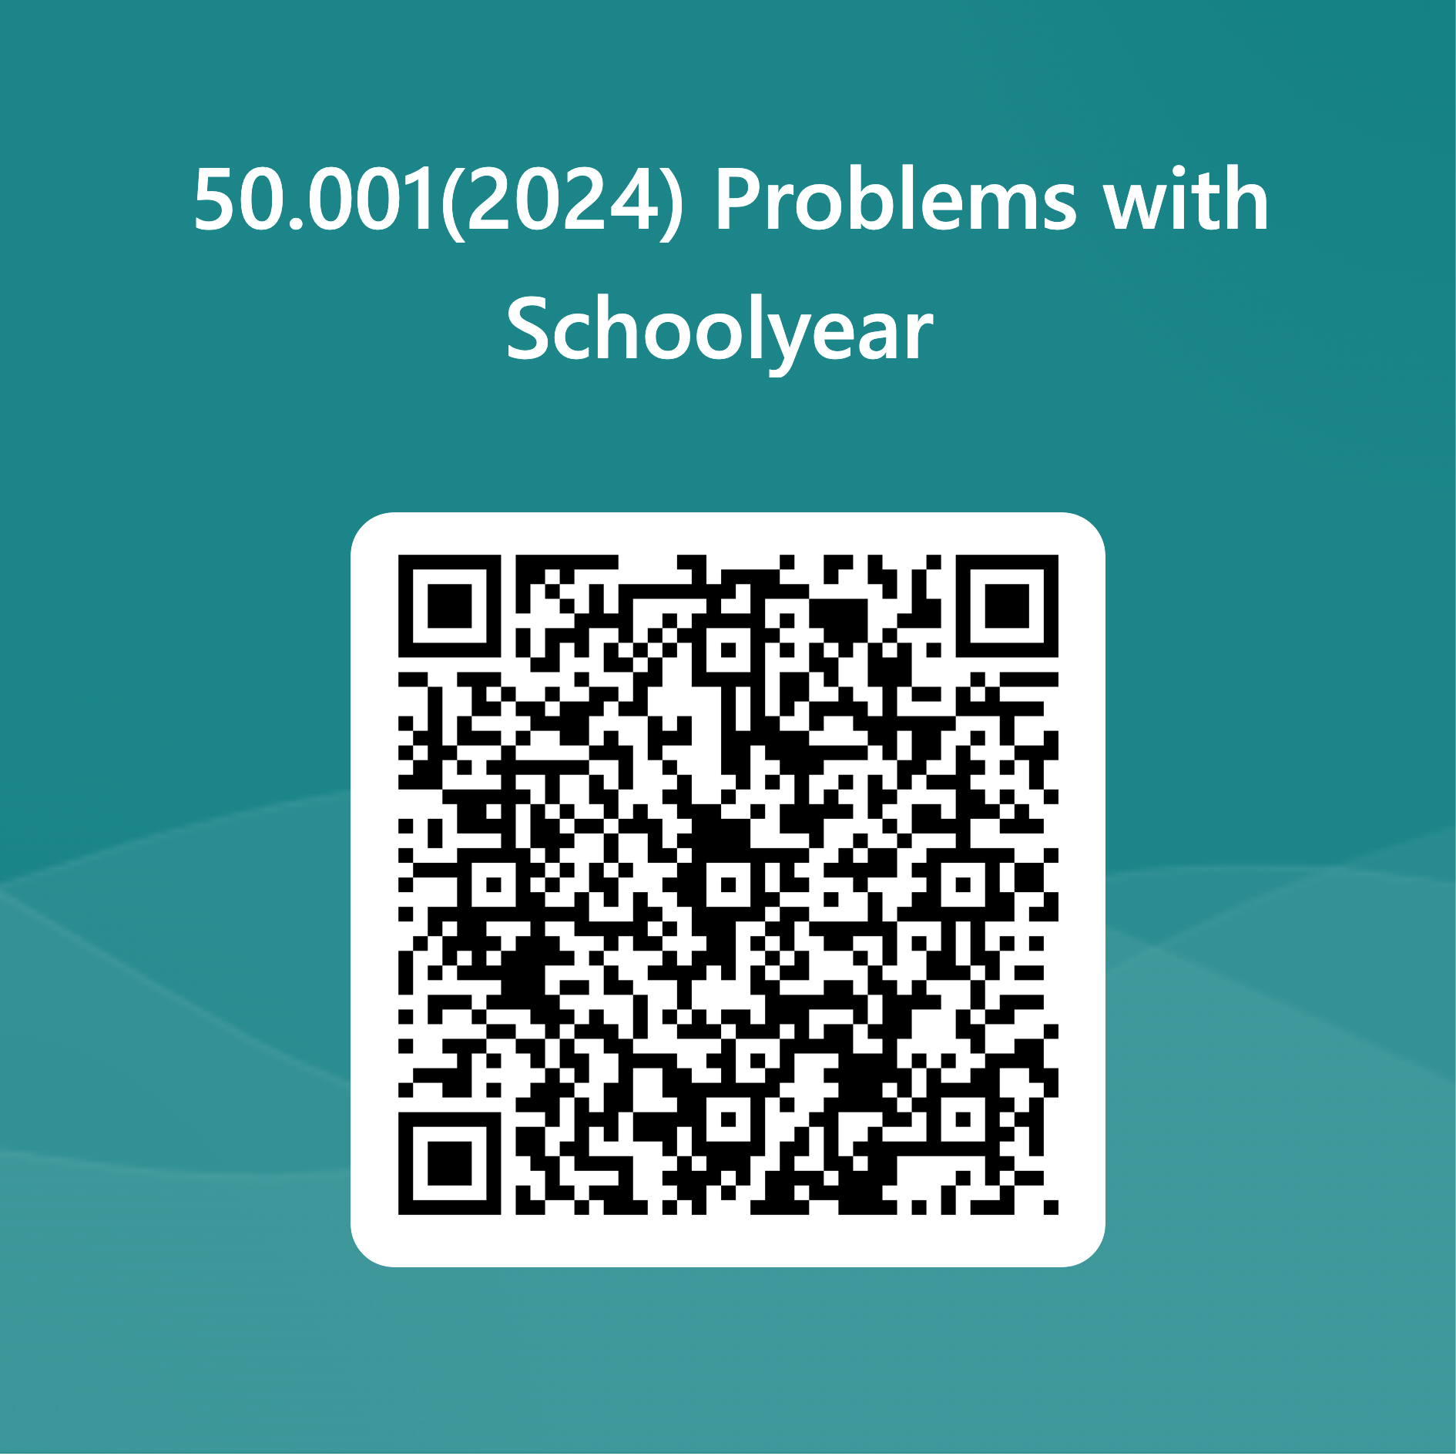
Schoolyear Cohort Exercise 4
We need you to self-report issues so that we can have a better picture of what is going on
Access Schoolyear Cohort Exercise from eDimension Week 1 – 6 Folder
Mac users: try using Chrome
Find and copy the URL to JavaDocs
open a new tab, paste the URL
Try searching for the ArrayList API reference
Your terminal should be available, if not, (1) refresh or (2) move to Question 2 and move back.
Avoid three-finger swipe gesture OR laptop screen at 45 degrees, otherwise invigilator needs to intervene
https://forms.office.com/r/XDX9Z7VSZL

